Slide 1
Spinal Instability Neoplastic Score & The “LMNOP” System
Spine Rounds
Ahmed Quateen

Slide 2
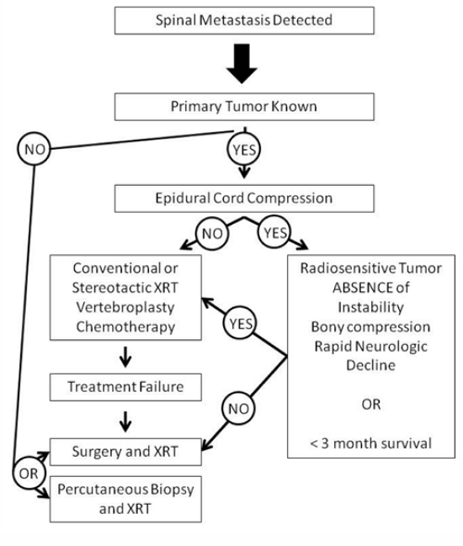

Slide 3
Stability and Mets
VBs support up to 80% of the axial load of the spine.
Consequently, osteolytic lesions of the VB, the most common site of metastasis, can significantly impact the loading capacity of the spine.
The degree of impact is determined by:
the size of the lesion,
cross-sectional area of the intact VB, and
overall bone mineral density.
As lytic lesions grow in size, they can undermine the integrity of the VB

Slide 4
Instability …
likelihood of pathological fracture could be predicted by calculating the product of cross-sectional area of the intact bone and bone mineral density.
Taneichi et al. showed that collapse was predicted by 50–60% VB lysis in the thoracic spine and 35– 45% in the lower thoracic/lumbar spine.
Segments of high mobility or stress, such as the cervicothoracic and thoracolumbar junctions, are likely to be subject to fracture with less tumor burden.
Metastases to the dorsal elements of the spinal column, especially the facet joints, are believed to predispose patients to pathological dislocation, spondylolysis, and translational instability

Slide 5
Instability
Cybulski proposed imaging criteria for the assessment of spine instability due to tumors; these were as follows:
1) anterior and middle column destruction (> 50% collapse of VB height);
2) collapse of 2 or more adjacent VBs;
3) tumor involvement of the middle and posterior columns (possibility of forward shear deformity);
4) previous surgical laminectomy, with failure to recognize anterior and middle column disease.
This study recommended surgical decompression and fixation when one of these instability criteria is met or when neural compression is present in patients with a life expectancy of > 5–6 months, competent immune and nutritional status, incomplete neurological deficit, and a radioresistant tumor or a tumor that failed to respond to previous treatment.

Slide 6
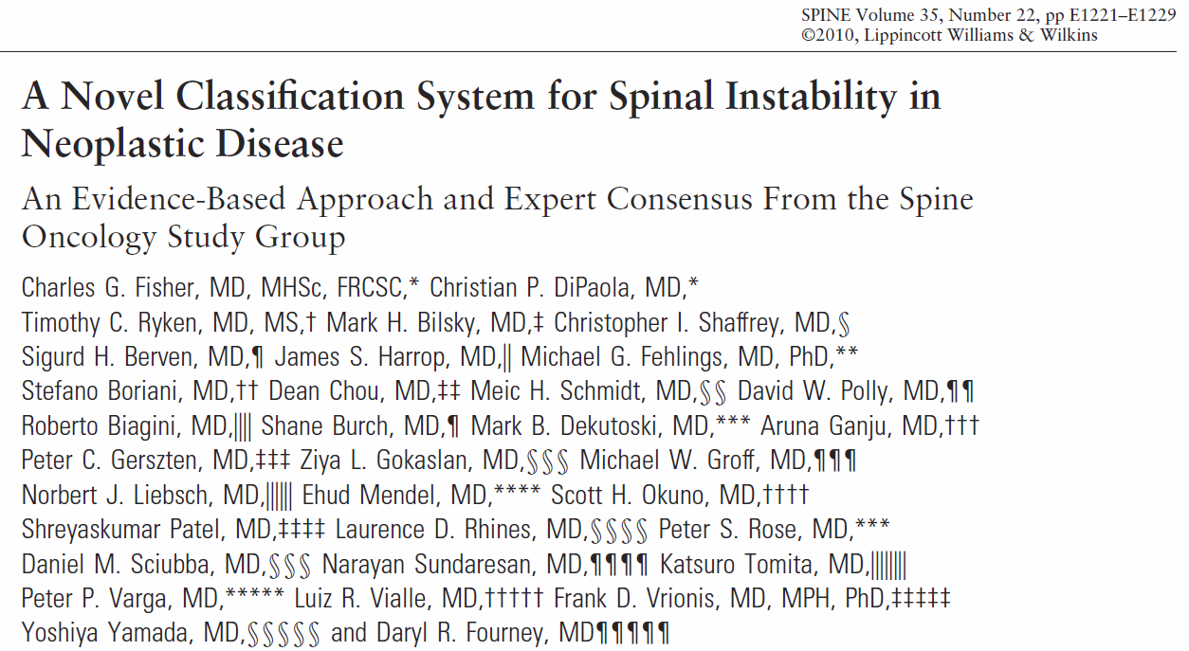

Slide 7
Components
Location
Mechanical back pain
Characteristic of the Bone lesion
Radiographic spinal alignment
Vertebral body collapse
Posterolateral involvement
modifying factors (not scored but should be considered)
Score 0 – 18 …
Scores of 0 to 6 denote “stability,”
scores of 7 to 12 denote “indeterminate (possibly impending) instability,” and
scores of 13 to 18 denote “instability.”
Patients with SINS scores of 7 to 18 warrant surgical consultation

Slide 8
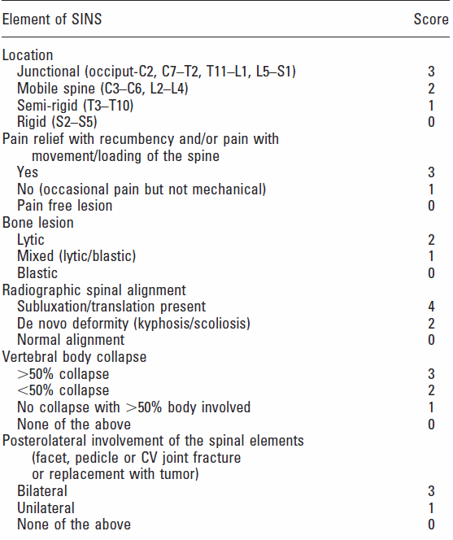

Slide 9
modifying factors
Multilevel (contiguous) spinal disease. (the role of noncontiguous lesions is also not fully established. )
Previous laminectomies or other surgical procedures and previous radiation therapy (including radiosurgery).
The extent of diffuse bony involvement of metastatic disease and likely poor bone quality.
Patient body weight and activity level may also influence spinal loading and impending instability.

Slide 10
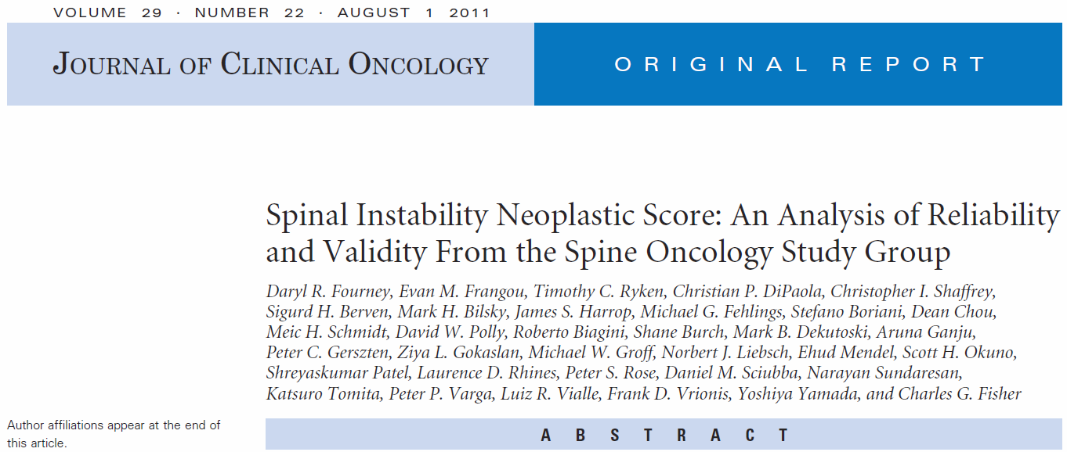
Conclusion
SINS demonstrated near-perfect inter- and intraobserver reliability in determining three clinically relevant categories of stability.
The sensitivity and specificity of SINS for potentially unstable or unstable lesions were 95.7% and 79.5%, respectively

Slide 11
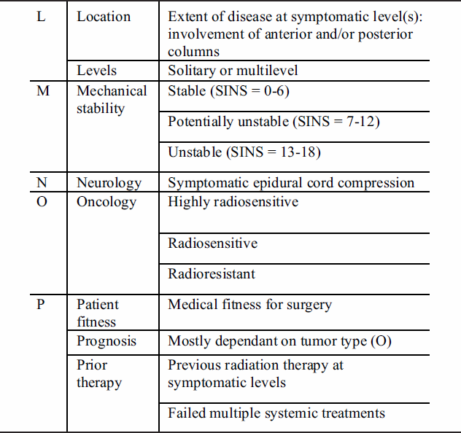
The “LMNOP” System

